Slide 1
1.5 Complements
There are two types of complements for each base-r system: the radix complement and diminished radix complement.
Diminished Radix Complement - (r-1)’s Complement
Given a number N in base r having n digits, the (r–1)’s complement of N is defined as:
(r^{n} –1) – N
Example for 6-digit decimal numbers:
9’s complement is (r^{n} – 1)–N = (10⁶–1)–N = 999999–N
9’s complement of 546700 is 999999–546700 = 453299
Example for 7-digit binary numbers:
1’s complement is (r^{n} – 1) – N = (2⁷–1)–N = 1111111–N
1’s complement of 1011000 is 1111111–1011000 = 0100111
Observation:
Subtraction from (r^{n} – 1) will never require a borrow
Diminished radix complement can be computed digit-by-digit
For binary: 1 – 0 = 1 and 1 – 1 = 0

Slide 2
Complements
1’s Complement (Diminished Radix Complement)
All ‘0’s become ‘1’s
All ‘1’s become ‘0’s
Example (10110000)₂
⇨ (01001111)₂
If you add a number and its 1’s complement …
1 0 1 1 0 0 0 0
+ 0 1 0 0 1 1 1 1
1 1 1 1 1 1 1 1

Slide 3
Complements
Radix Complement
Example: Base-10
Example: Base-2
The r's complement of an n-digit number N in base r is defined as
r^{n} – N for N ≠ 0 and as 0 for N = 0. Comparing with the (r − 1) 's complement, we note that the r's complement is obtained by adding 1 to the (r − 1) 's complement, since r^{n} – N = [(r^{n} − 1) – N] + 1.
The 10's complement of 012398 is 987602
The 10's complement of 246700 is 753300
The 2's complement of 1101100 is 0010100
The 2's complement of 0110111 is 1001001

Slide 4
Complements
2’s Complement (Radix Complement)
Take 1’s complement then add 1
Toggle all bits to the left of the first ‘1’ from the right
Example:
Number:
1’s Comp.:
OR
1 0 1 1 0 0 0 0
0 1 0 0 1 1 1 1
+ 1
1 0 1 1 0 0 0 0
0 1 0 1 0 0 0 0
0
1
0
1
0
0
0
0

Slide 5
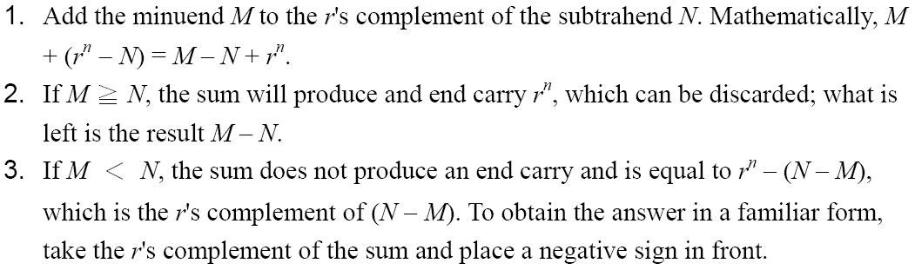
Complements
Subtraction with Complements
The subtraction of two n-digit unsigned numbers M – N in base r can be done as follows:

Slide 6
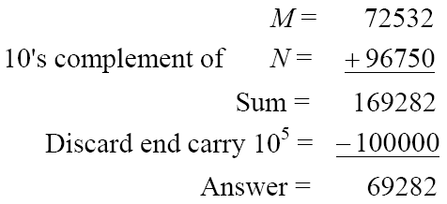
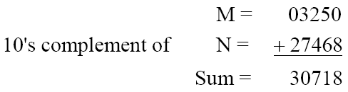
Complements
Example 1.5
Using 10's complement, subtract 72532 – 3250.
Example 1.6
Using 10's complement, subtract 3250 – 72532.
There is no end carry.
Therefore, the answer is – (10's complement of 30718) = − 69282.

Slide 7
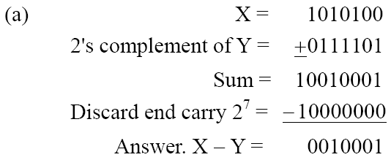
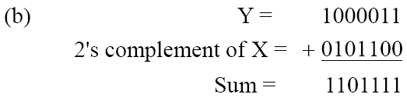
Complements
Example 1.7
Given the two binary numbers X = 1010100 and Y = 1000011, perform the subtraction (a) X – Y ; and (b) Y − X, by using 2's complement.
There is no end carry. Therefore, the answer is Y – X = − (2's complement of 1101111) = − 0010001.

Slide 8
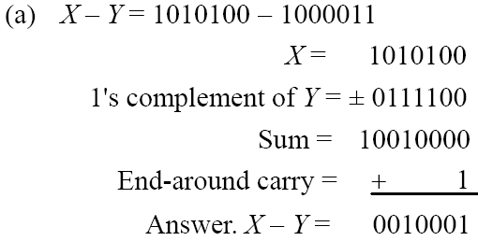
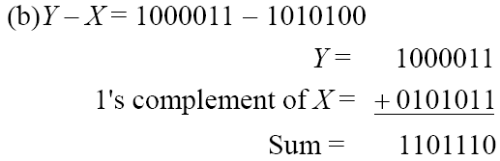
Complements
Subtraction of unsigned numbers can also be done by means of the (r − 1)'s complement. Remember that the (r − 1) 's complement is one less then the r's complement.
Example 1.8
Repeat Example 1.7, but this time using 1's complement.
There is no end carry, Therefore, the answer is Y – X = − (1's complement of 1101110) = − 0010001.

Slide 9
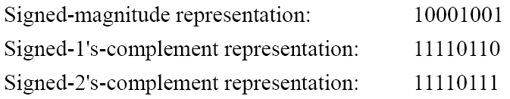
1.6 Signed Binary Numbers
To represent negative integers, we need a notation for negative values.
It is customary to represent the sign with a bit placed in the leftmost position of the number since binary digits.
The convention is to make the sign bit 0 for positive and 1 for negative.
Example:
Table 1.3 lists all possible four-bit signed binary numbers in the three representations.

Slide 10
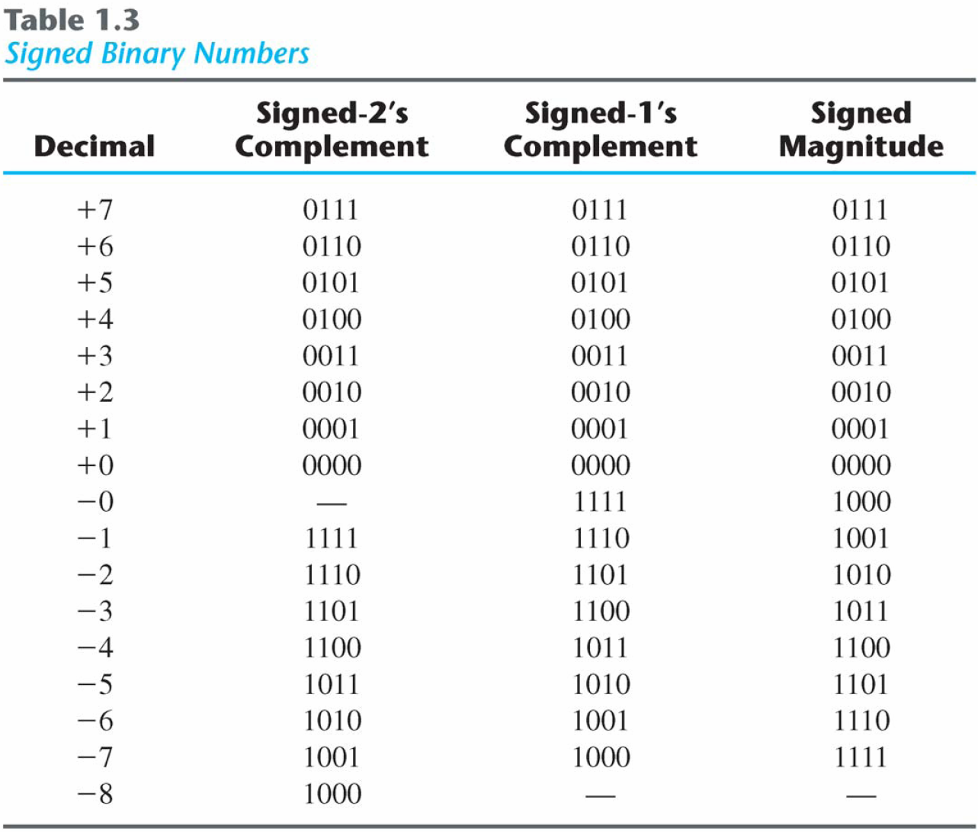
Signed Binary Numbers

Slide 11
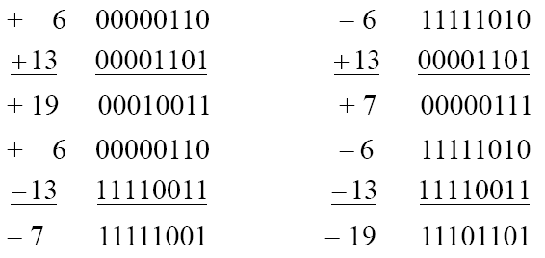
Signed Binary Numbers
Arithmetic addition
The addition of two numbers in the signed-magnitude system follows the rules of ordinary arithmetic. If the signs are the same, we add the two magnitudes and give the sum the common sign. If the signs are different, we subtract the smaller magnitude from the larger and give the difference the sign if the larger magnitude.
The addition of two signed binary numbers with negative numbers represented in signed-2's-complement form is obtained from the addition of the two numbers, including their sign bits.
A carry out of the sign-bit position is discarded.
Example:

Slide 12
Signed Binary Numbers
Arithmetic Subtraction
In 2’s-complement form:
Example:
Take the 2’s complement of the subtrahend (including the sign bit) and add it to the minuend (including sign bit).
A carry out of sign-bit position is discarded.
(− 6) − (− 13)
(11111010 − 11110011)
(11111010 + 00001101)
00000111 (+ 7)

Slide 13
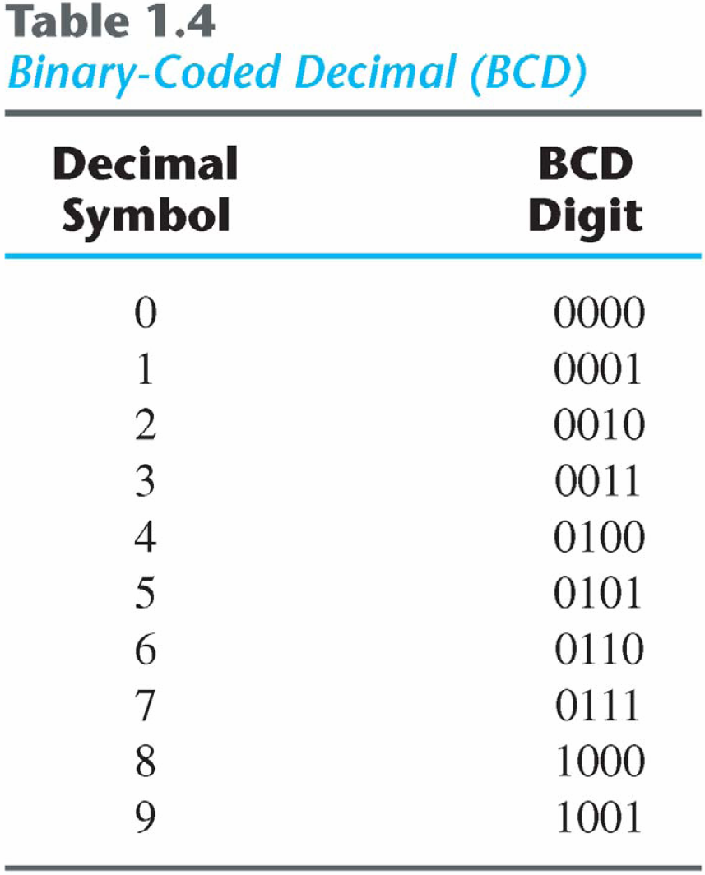
1.7 Binary Codes
BCD Code
A number with k decimal digits will require 4k bits in BCD.
Decimal 396 is represented in BCD with 12bits as 0011 1001 0110, with each group of 4 bits representing one decimal digit.
A decimal number in BCD is the same as its equivalent binary number only when the number is between 0 and 9.
The binary combinations 1010 through 1111 are not used and have no meaning in BCD.

Slide 14
Binary Code
Example:
Consider decimal 185 and its corresponding value in BCD and binary:
BCD addition

Slide 15
Binary Code
Example:
Consider the addition of 184 + 576 = 760 in BCD:
Decimal Arithmetic: (+375) + (-240) = +135
Hint 6: using 10’s of BCD

Slide 16
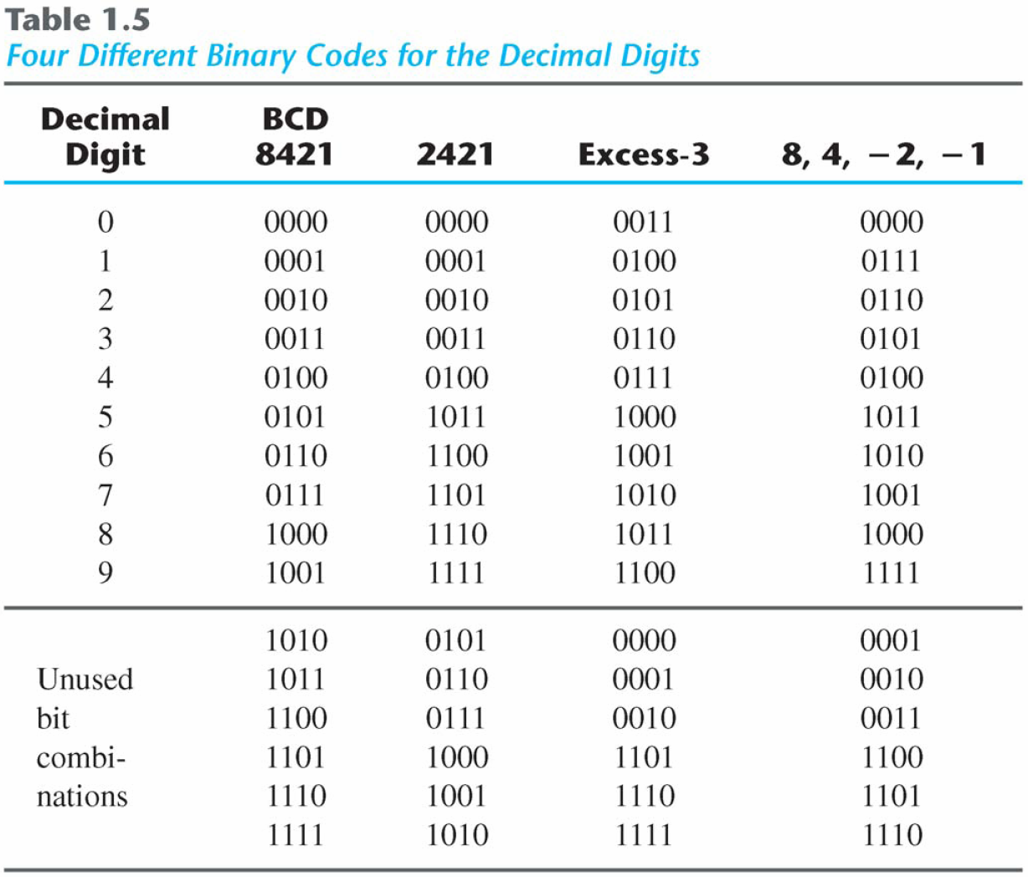
Binary Codes
Other Decimal Codes

Slide 17
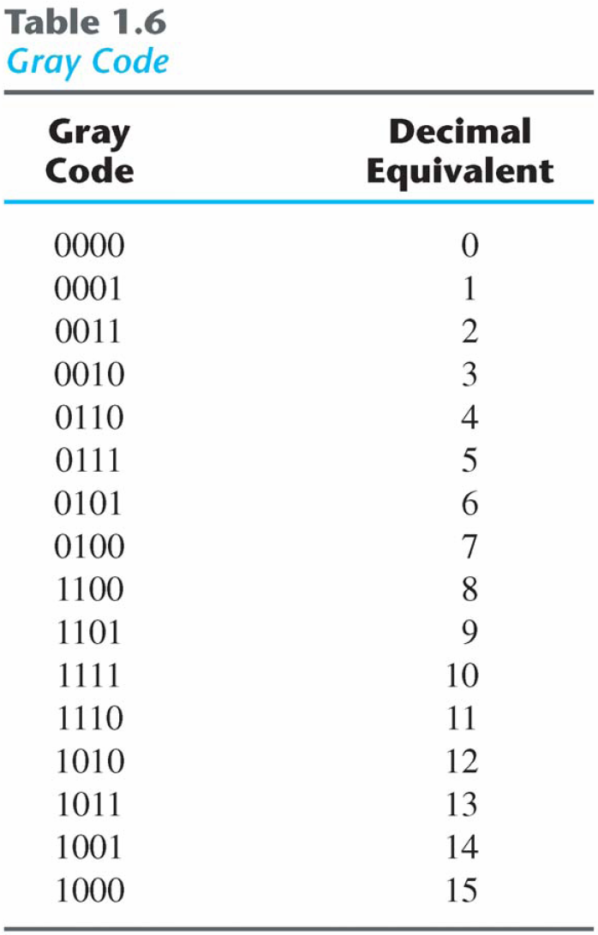
Binary Codes)
Gray Code
The advantage is that only bit in the code group changes in going from one number to the next.
Error detection.
Representation of analog data.
Low power design.
000
001
010
011
100
101
110
111
1-1 and onto!!

Slide 18
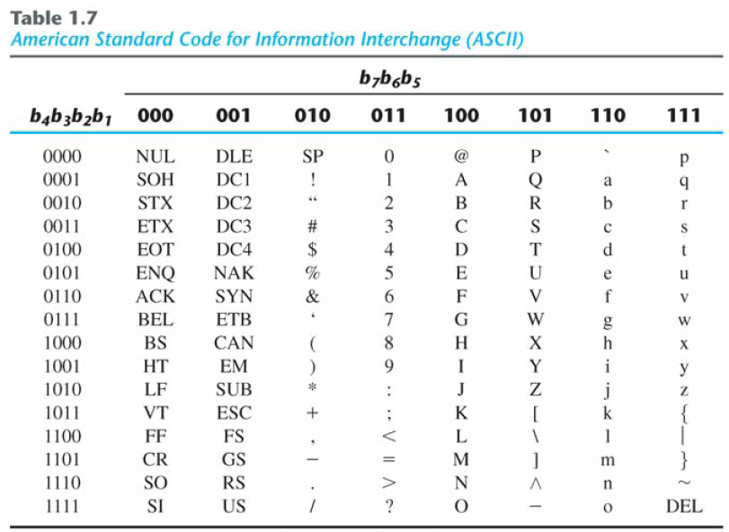
Binary Codes
American Standard Code for Information Interchange (ASCII) Character Code

Slide 19
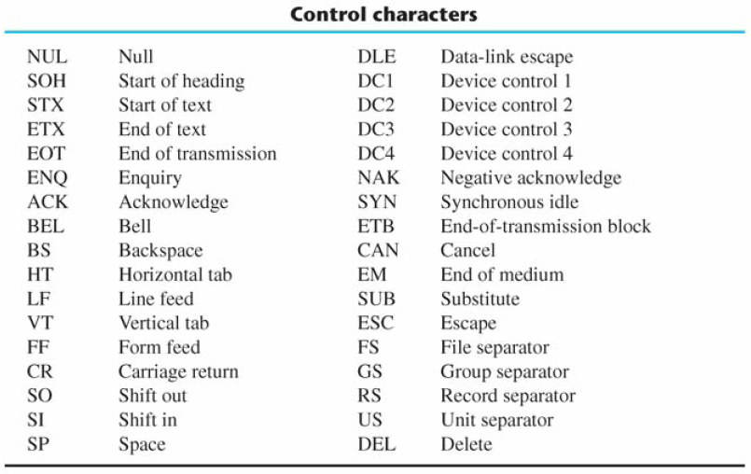
Binary Codes
ASCII Character Code

Slide 20
ASCII Character Codes
American Standard Code for Information Interchange (Refer to Table 1.7)
A popular code used to represent information sent as character-based data.
It uses 7-bits to represent:
94 Graphic printing characters.
34 Non-printing characters.
Some non-printing characters are used for text format (e.g. BS = Backspace, CR = carriage return).
Other non-printing characters are used for record marking and flow control (e.g. STX and ETX start and end text areas).

Slide 21
ASCII Properties
ASCII has some interesting properties:
Digits 0 to 9 span Hexadecimal values 30₁₆ to 39₁₆
Upper case A-Z span 41₁₆ to 5A₁₆
Lower case a-z span 61₁₆ to 7A₁₆
Lower to upper case translation (and vice versa) occurs by flipping bit 6.

Slide 22
Binary Codes
Error-Detecting Code
To detect errors in data communication and processing, an eighth bit is sometimes added to the ASCII character to indicate its parity.
A parity bit is an extra bit included with a message to make the total number of 1's either even or odd.
Example:
Consider the following two characters and their even and odd parity:

Slide 23
Binary Codes
Error-Detecting Code
Redundancy (e.g. extra information), in the form of extra bits, can be incorporated into binary code words to detect and correct errors.
A simple form of redundancy is parity, an extra bit appended onto the code word to make the number of 1’s odd or even. Parity can detect all single-bit errors and some multiple-bit errors.
A code word has even parity if the number of 1’s in the code word is even.
A code word has odd parity if the number of 1’s in the code word is odd.
Example:
Message A:
10001001
(even parity)
1
Message B:
10001001
(odd parity)
0

Slide 24
1.8 Binary Storage and Registers
Registers
A binary cell is a device that possesses two stable states and is capable of storing one of the two states.
A register is a group of binary cells. A register with n cells can store any discrete quantity of information that contains n bits.
A binary cell
Two stable state
Store one bit of information
Examples: flip-flop circuits, ferrite cores, capacitor
A register
A group of binary cells
AX in x86 CPU
Register Transfer
A transfer of the information stored in one register to another.
One of the major operations in digital system.
An example in next slides.
n cells
2^{n} possible states

Slide 25
A Digital Computer Example
Inputs: Keyboard, mouse, modem, microphone
Outputs: CRT, LCD, modem, speakers
Synchronous or Asynchronous?

Slide 26
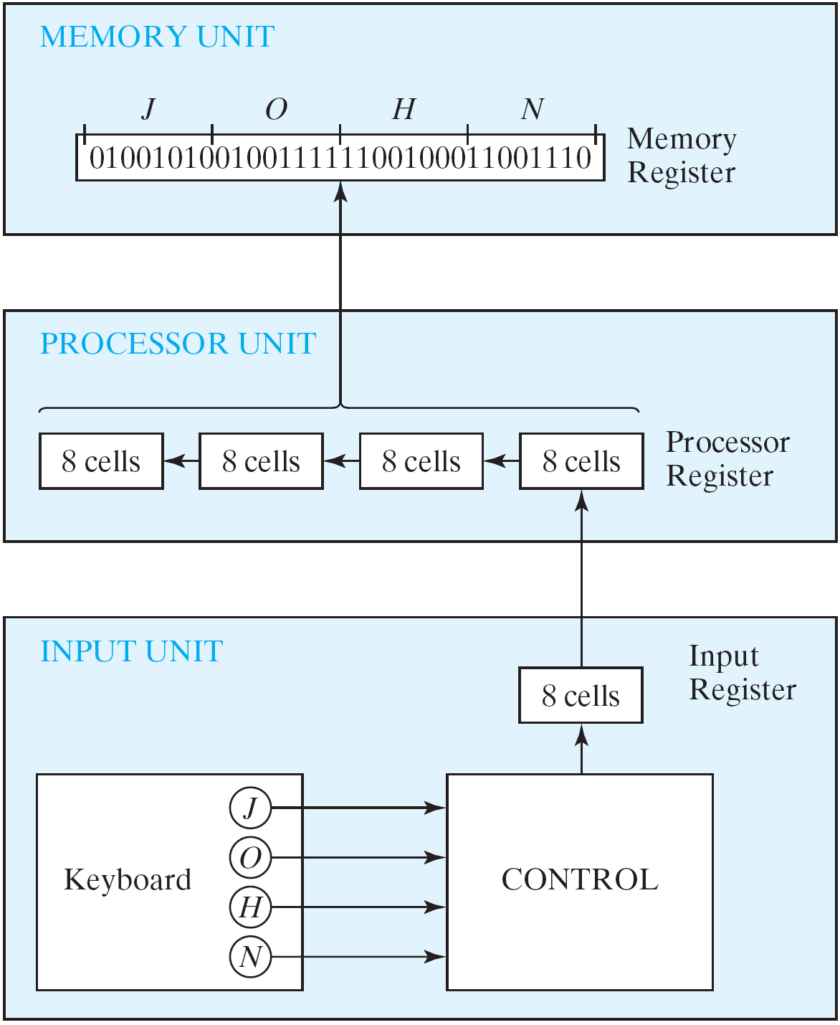
Transfer of information
Figure 1.1 Transfer of information among register

Slide 27
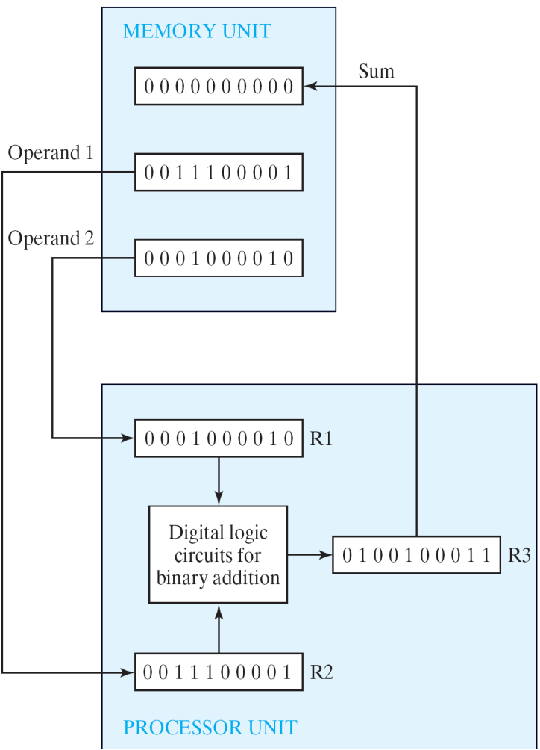
Transfer of information
The other major component of a digital system
Circuit elements to manipulate individual bits of information
Load-store machine
LD R1;
LD R2;
ADD R2, R1;
SD R3;
Figure 1.2 Example of binary information processing

Slide 28
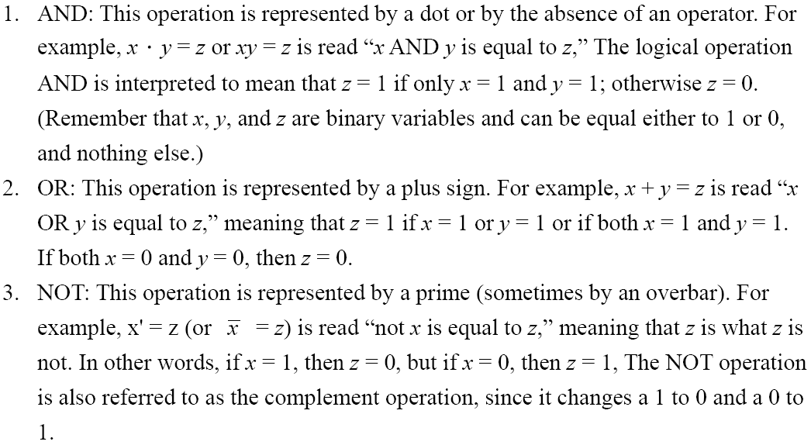
1.9 Binary Logic
Definition of Binary Logic
Binary logic consists of binary variables and a set of logical operations.
The variables are designated by letters of the alphabet, such as A, B, C, x, y, z, etc, with each variable having two and only two distinct possible values: 1 and 0,
Three basic logical operations: AND, OR, and NOT.

Slide 29
Binary Logic
Truth Tables, Boolean Expressions, and Logic Gates
AND
OR
NOT
x | y | z
0 | 0 | 0
0 | 1 | 0
1 | 0 | 0
1 | 1 | 1
x | y | z
0 | 0 | 0
0 | 1 | 1
1 | 0 | 1
1 | 1 | 1
x | z
0 | 1
1 | 0
z = x • y = x y
z = x + y
z = x = x’

Slide 30
Switching Circuits
AND
OR

Slide 31
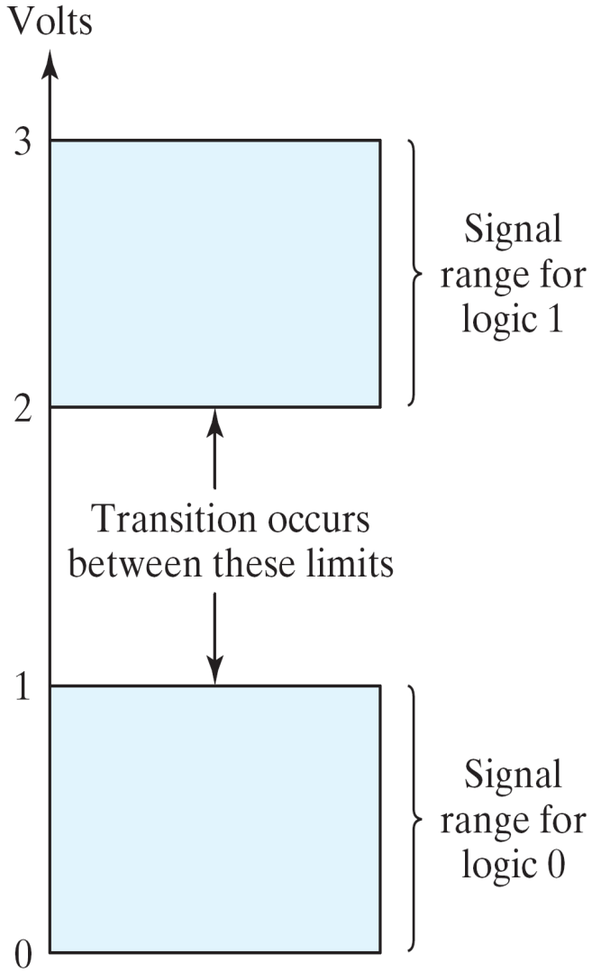
Binary Logic
Logic gates
Example of binary signals
3
Logic 1
2
Un-define
1
Logic 0
0
Figure 1.3 Example of binary signals

Slide 32
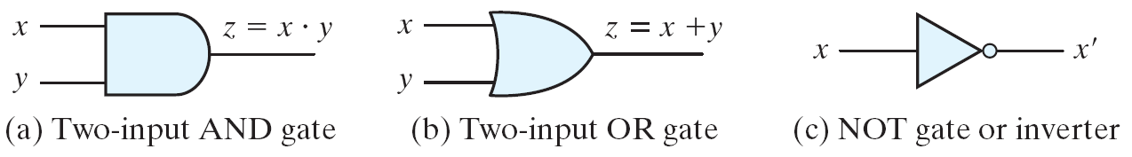
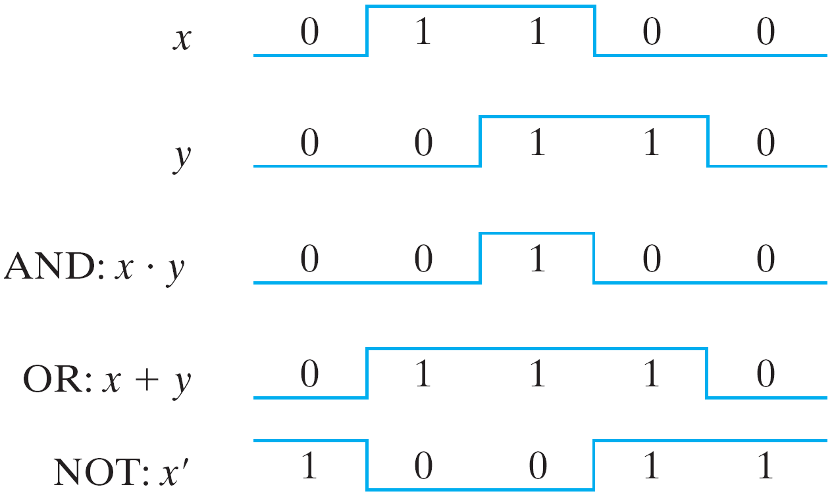
Binary Logic
Logic gates
Graphic Symbols and Input-Output Signals for Logic gates:
Fig. 1.4 Symbols for digital logic circuits
Fig. 1.5 Input-Output signals for gates

Slide 33
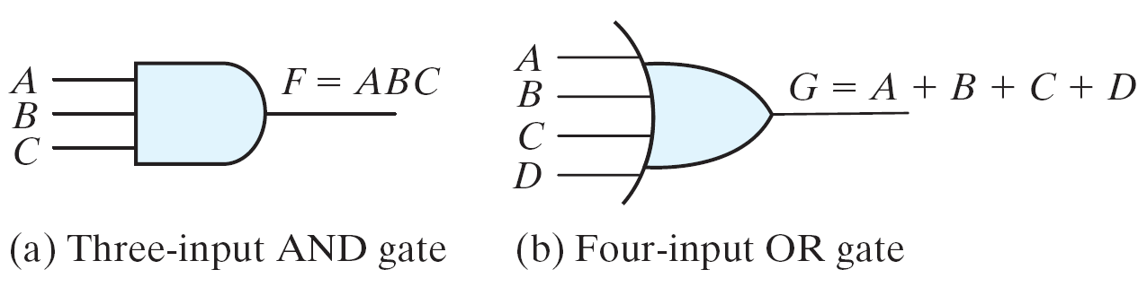
Binary Logic
Logic gates
Graphic Symbols and Input-Output Signals for Logic gates:
Fig. 1.6 Gates with multiple inputs

